Slide 1
C character set, C tokens
Mohamed Rahman Shareff S

Slide 2
C character set
A character refers to the digit, alphabet or special symbol used to data representation. C language character set contains the following set of characters...
Alphabets: Lower and upper case letters together support 52 alphabets.
lower case letters - a to z
UPPER CASE LETTERS - A to Z
Digits : 0, 1, 2, 3, 4, 5, 6, 7, 8, 9

Slide 3
C character set
Special Symbols: @ # $ % ^ & * ( ) _ - + = { } [ ] ; : ' " / ? . > , < \ | tab newline space NULL bell backspace vertical tab etc.,
White spaces (blank spaces): Horizontal tab, Carriage return, New line, form feed

Slide 4
C Tokens
C tokens are the basic buildings blocks in C language which are constructed together to write a C program.
Each and every smallest individual unit in a C program is known as C tokens.
C has Six Types of tokens:.
1. Keywords
2. Identifiers
3. Constants
4. Strings
5. Special Symbols
6. Operators

Slide 5
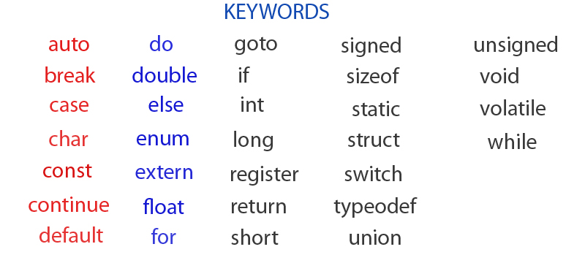
Keywords
Keywords are defined those variables which have a special meaning and are pre defined in the C libraries
(Eg): for, else, if, main, etc,.

Slide 6
Constants/Literals in C
Constant in ‘C’ refers to fixed value & do not change during the execution of a program.
1. Integer Constants
2. Real Constants / Floating Point Constants
3. Character Constants
4. String Constants

Slide 7
Integer Constants
An integer constant is a sequence of digit
Decimal integer constant
Octal integer constant
Hexa Decimal integer constant

Slide 8
Decimal Integers
consists of a set of digits 0 to 9 preceded by an optional + or - sign. Spaces, commas and non digit characters are not permitted between digits.
consists of a set of digits 0 to 9 preceded by an optional + or - sign. Spaces, commas and non digit characters are not permitted between digits.

Slide 9
Octal & Hexa Decimal integer
Octal Integers constant : consists of any combination of digits from 0 through 7 with a 0 at the beginning.
Examples: 026, 0, 0347, 0676
Hexadecimal integer constant is preceded by 0X or 0x, they may contain alphabets from A to F or a to f. The alphabets A to F refers to 10 to 15 in decimal digits.
Example of valid hexadecimal integers are
0X2, 0X8C, 0Xbcd, 0x

Slide 10
Real Constants
Consists of a fractional part in their representation
Examples: 0.0026, -0.97, 435.29, +487.0
Real Numbers can also be represented by exponential notation. The general form for exponential
notation is mantissa exponent. The mantissa is either a real number expressed in decimal notation or an integer
Ex. 0.5e4

Slide 11
Character Constant
Every number, symbol or a digit in a single quotes called character constants.
Single Character Constant:
A character constant is a single character, enclosed in single quotation marks.
e.g., ‘A’ ‘B’ ‘1’.
The value of a character constant is the numeric value of the character in the machine’s character set.
For example, on ASCII machine the value of ‘A’ is 65.

Slide 12
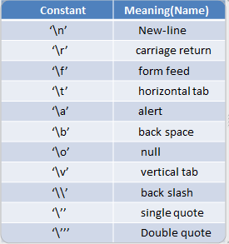
Escape Sequence Character/Backslash Character
C supports some special escape sequence characters that are used to do special tasks. These are also called as 'Backslash characters.

Slide 13
String Constants
String constant is a set of characters enclosed in double quotation marks
It may contain letters, digits, special characters and blank space.
Example :"VISHAL", "1234", "God Bless", "!.....?"

